Slide 1
Visualising employee Attendence Trends with excel charts

Slide 2
Introduction
• It can often be difficult to interpret Excel workbooks that contain a lot of data. Charts allow you to illustrate your workbook data graphically, which makes it easy to visualize comparisons and trends.

Slide 3
TO
To insert a chart
• Select the cells you want to chart, including the column titles and row labels. These cells will be the source data for the chart.
• From the Insert tab, click the desired Chart command. In our example, we'll select Column.
• Choose the desired chart type from the drop-down menu.
• The selected chart will be inserted in the worksheet.
• If you're not sure which type of chart to use, the Recommended Charts command will suggest several different charts based on the source data.

Slide 4
TYPES
• Excel has several different types of charts, allowing you to choose the one that best fits your data. In order to use charts effectively, you'll need to understand how different charts are used. here I m explaining 12 types of charts.

Slide 5
COLUMN CHARTS
• Column charts use vertical bars to represent data. They can work with many different types of data, but they're most frequently used for comparing information

Slide 6
LINE CHARTS
• Line charts are ideal for showing trends. The data points are connected with lines, making it easy to see whether values are increasing or decreasing over time.

Slide 7
PIE CHARTS
• Pie charts make it easy to compare proportions. Each value is shown as a slice of the pie, so it's easy to see which values make up the percentage of a whole

Slide 8
BAR CHARTS
• Bar charts work just like column charts, but they use horizontal bars instead of vertical bars.

Slide 9
AREA CHARTS
• Area charts are similar to line charts, except the areas under the lines are filled in.

Slide 10
SURFACE CHARTS
• Surface charts allow you to display data across a 3D landscape. They work best with large data sets, allowing you to see a variety of information at the same time

Slide 11
PARETO CHARTS
Pareto charts• The Pareto Chart is a built-in chart type in Excel 2016. A Pareto chart is a variant of the histogram chart, arranged in descending order for easy analysis. The sequencing is performed automatically.

Slide 12
CANDLESTICK CHARTS
• This chart type automatically plots the full range of values as a single line, with indicates high and low in a given time interval. On top of the line is a bar which indicates open and close values

Slide 13
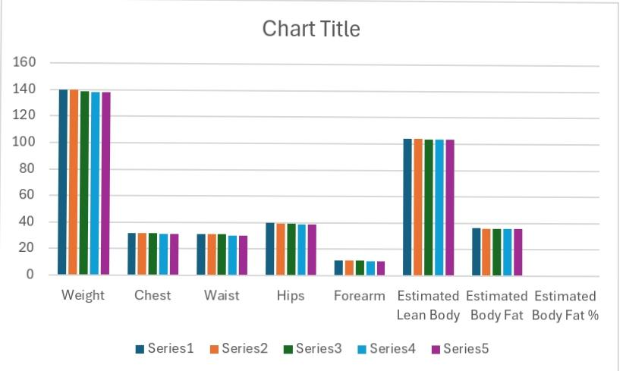
Result

Slide 14
conclusion
A Candlestick chart is a built-in chart type in Excel normally used to show stock price activity. You'll find this chart under the Stock category of chart types, with the name Open-High-Low-Close, sometimes abbreviated OHLC. Dark bars indicate close price is less than open price (a loss), light bars indicate a close price greater than open price (a gain).

